Slide 1

IKM-HS Superfund Site:
Town council Meeting
August 22, 2023

Slide 2
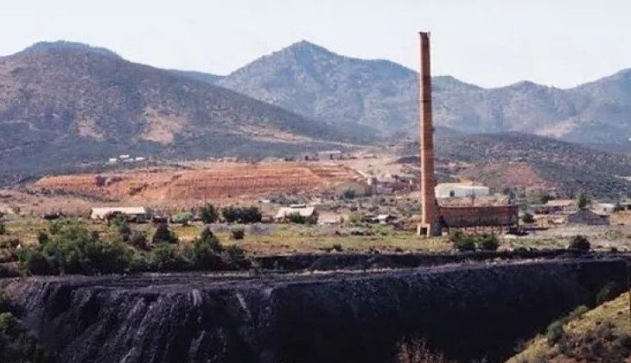
BACKGROUND
  Town Council’s May 13, 2023 Letter to EPA (unanimously approved, signed)
  Core messages –
    The Town supports EPA’s proposed remedial alternative
    But, the “institutional control” dimension of EPA’s remedy was inadequately developed, putting the remedy and Town at risk
    EPA, ADEQ, and the Town need to partner on IC development because the Town must be the primary IC adopter and enforcer

Slide 3
BACKGROUND
  What are “institutional controls”?
    EPA’s rulebook for Superfund remedial action provides that any remedy that leaves waste or waste residuals in place MUST have two components -- “engineering controls” and “institutional controls”

Slide 4
BACKGROUND
  “Engineering controls” --
    Physical, engineered measures that minimize human exposure to waste or waste residuals left at a site by limiting direct contact with such materials and/or controlling their migration in the environment
    Examples include caps, covers, barriers, vapor mitigation systems, hydraulic groundwater controls

Slide 5
BACKGROUND
  “Institutional controls” --
    Non-engineered, administratively and legally enforceable measures that guide and manage human behavior at a site to minimize human exposure to waste left in place and to protect the integrity of the site’s engineering controls
    Examples include deed notices, land use restrictions, zoning and building codes, groundwater use restrictions, consent decrees, information advisories

Slide 6
BACKGROUND
  Why did the Town Council take the position it did on ICs in its May 13 letter to EPA?
    First, in developing and proposing its remedy, EPA focused primarily on ECs, and neglected development of ICs
    As a result, the long-term effectiveness of EPA’s remedy is jeopardized, leaving the Town and its residents at risk

Slide 7
BACKGROUND
  Why did the Town Council take the position it did on ICs in its May 13 letter to EPA?
    Second, the ICs that EPA did suggest might accompany the proposed ECs are largely outside EPA’s (and ADEQ’s) authority to adopt, administer and enforce
    By contrast, the Town has the authority to adopt, administer and enforce ICs needed to protect EPA’s remedy and Town residents

Slide 8
BACKGROUND
  Why did the Town Council take the position it did on ICs in its May 13 letter to EPA?
    Third, the Town has more at stake in developing, adopting, and administering ICs than EPA or ADEQ
    The Town is closer to the matters to be regulated by the ICs and thus is better positioned to monitor IC compliance
    The Town will live with the waste repositories long after EPA and ADEQ depart

Slide 9
BACKGROUND
  What has been the initial response to the Town Council’s May 13 letter?
    July 24 EPA Regional Administrator Visit: EPA officials indicated that the letter was received and read, and EPA is ready and willing to engage with the Town on IC development
    August 7 ADEQ Director Meeting: Similar message, leading to the scheduling of a meeting on ICs later this week (August 24)

Slide 10
PURPOSE OF TODAY’S PRESENTATION
  Identify the specific ICs being considered for discussion with EPA/ADEQ
  Discuss –
    Intersection of IC development and general land use planning
    Importance of marrying EPA’s remedy with Town’s redevelopment options for remediated properties

Slide 11
Case study: midvale, UTAH
August 22, 2023

Slide 12
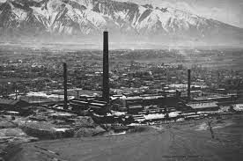
Case Study: Midvale, Utah
1871-1971: Industrial operations included -
  Five copper and lead smelters (all closed by 1958)
  Lead refinery (started in 1933)
  Lead, copper, and zinc ore processing and milling facilities (closed in 1971)

Slide 13
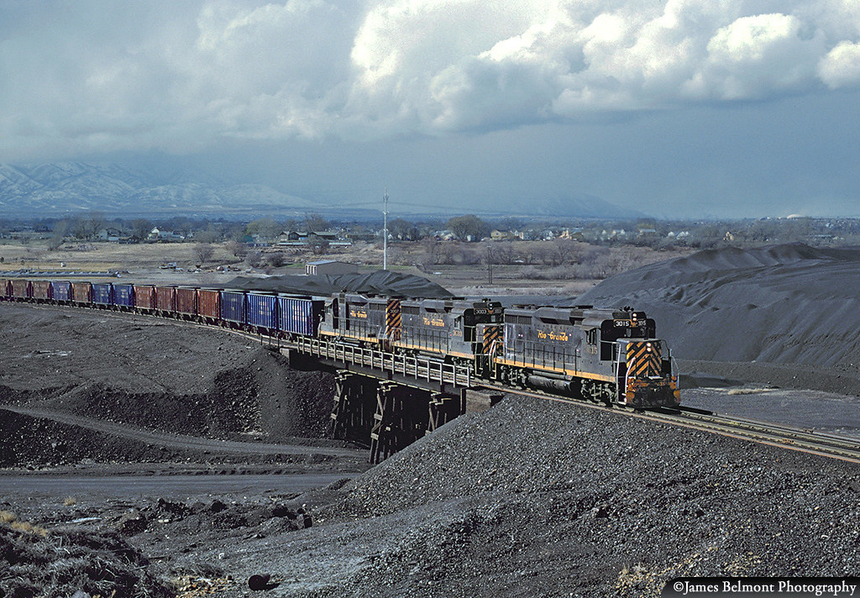
Case Study: Midvale, Utah
1871-1971: Environmental impacts included -
  Tailings (10,000,000 cubic yards up to 50 feet deep)
  Slag, baghouse dusts, demolition debris
  Smelter fume fallout, wind dispersion of tailings
  Surface water transport of tailings
  Residential, municipal reuse of tailings for fill, gardens, winter sanding of roads

Slide 14
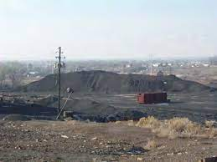
Case Study: Midvale, Utah
1980: Congress adopts Superfund law
1983: EPA/Utah DEQ conduct preliminary assessments of the abandoned smelter, refinery, milling complex
1986: EPA divides the Midvale complex into 2 Superfund sites and proposes each for addition to the NPL
  Sharon Steel Superfund Site (460 acres)
  Midvale Slag Superfund Site (446 acres)
1991: Both sites added to the NPL

Slide 15
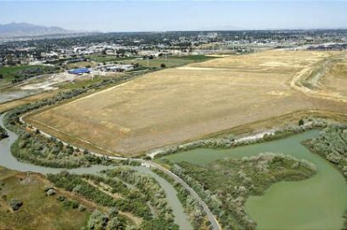
Case Study: Midvale, Utah
Sharon Steel Superfund Site
  1991-98: EPA performs remedial work
    Consolidating, regrading, capping and fencing 10,000,000 cubic yards of tailings
    Deed restrictions recorded strictly limiting future development
  1999: EPA declares remedial work completed

Slide 16
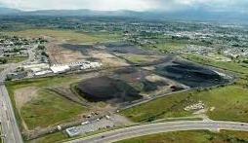
Case Study: Midvale, Utah
Midvale Slag Superfund Site
  1992: EPA divides site into 2 operable units (OUs)
    OU-1: Northern 266 acres
    OU-2: Southern 180 acres
  1995: EPA issues ROD for OU-1
    Residential soil removal/remedial actions
    Deed restrictions strictly limit future development

Slide 17
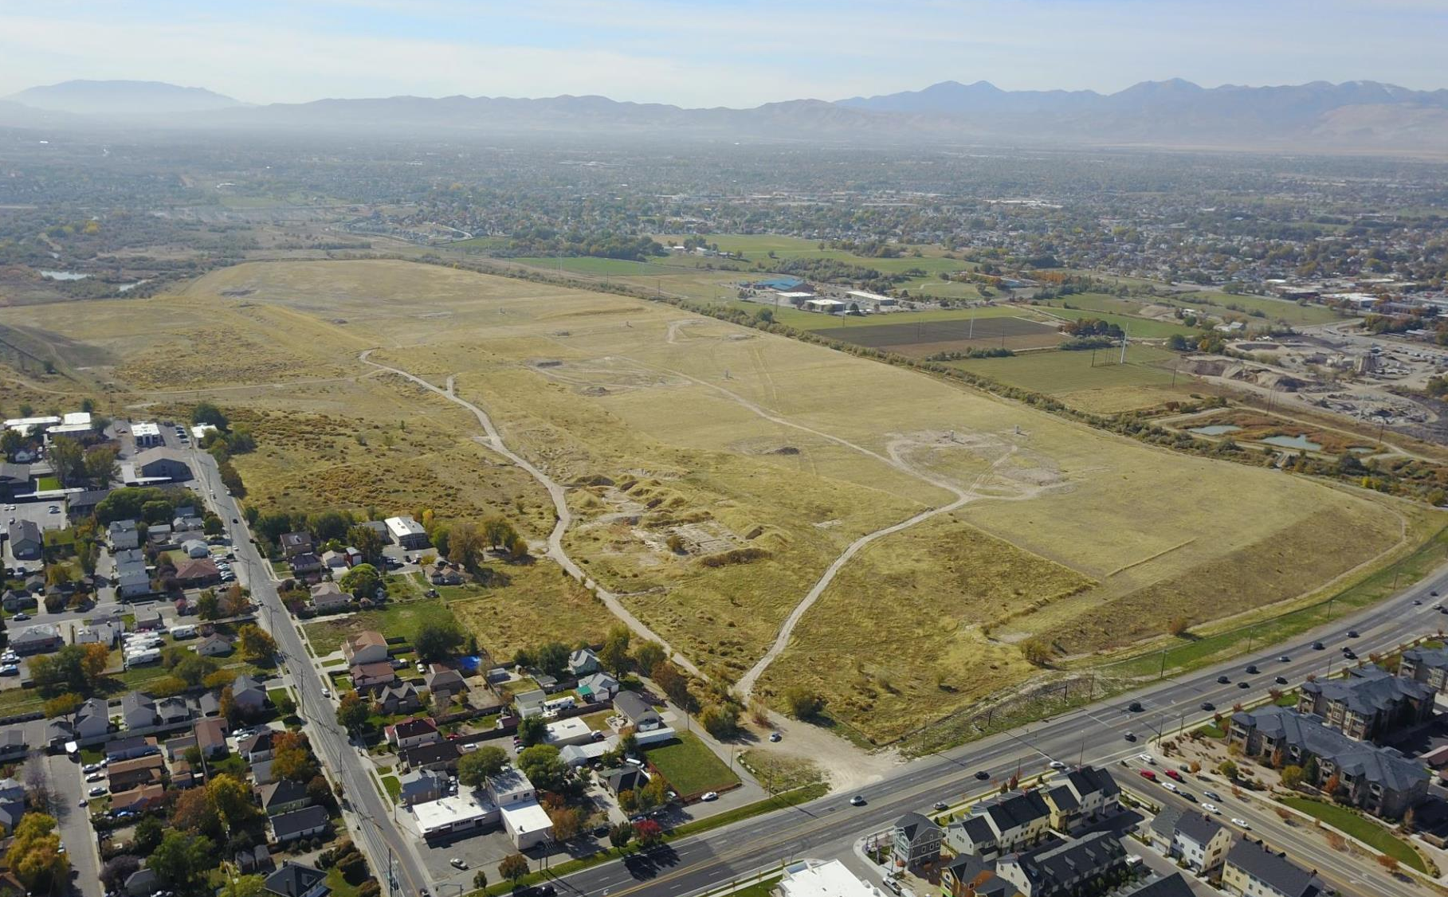
Case Study: Midvale, Utah
Midvale Slag Superfund Site
  1999: EPA completes remedial work on OU-1, turns its attention to OU-2
  PROBLEM:
    City faces rapid growth, with limited land availability
    Superfund-restricted properties comprise more than 700 acres near city center and major transportation routes

Slide 19
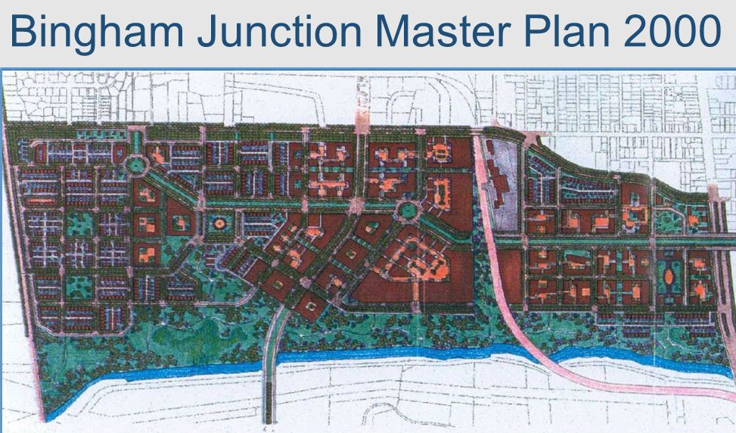
Case Study: Midvale, Utah
Midvale Slag Superfund Site
  1999-2000: City, EPA, Utah DEQ, PRP landowner discuss options
    Goal – transform environmentally impacted and Superfund-restricted land to a community asset
    Parties agree to marry remediation and reuse
    City adopts “Bingham Junction Master Plan”

Slide 20
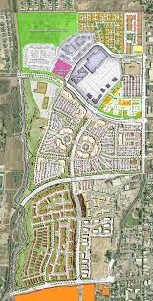
Case Study: Midvale, Utah
Midvale Slag Superfund Site
  2001: City rezones Midvale Slag Superfund Site, designating it the “Bingham Junction Zone”
  2002: EPA issues ROD for OU-2
    City’s reuse/redevelopment plan for area is identified as an “additional” remedial action objective guiding site cleanup
    EPA and City jointly develop ICs that protect the remedy and encourage reuse/redevelopment

Slide 21
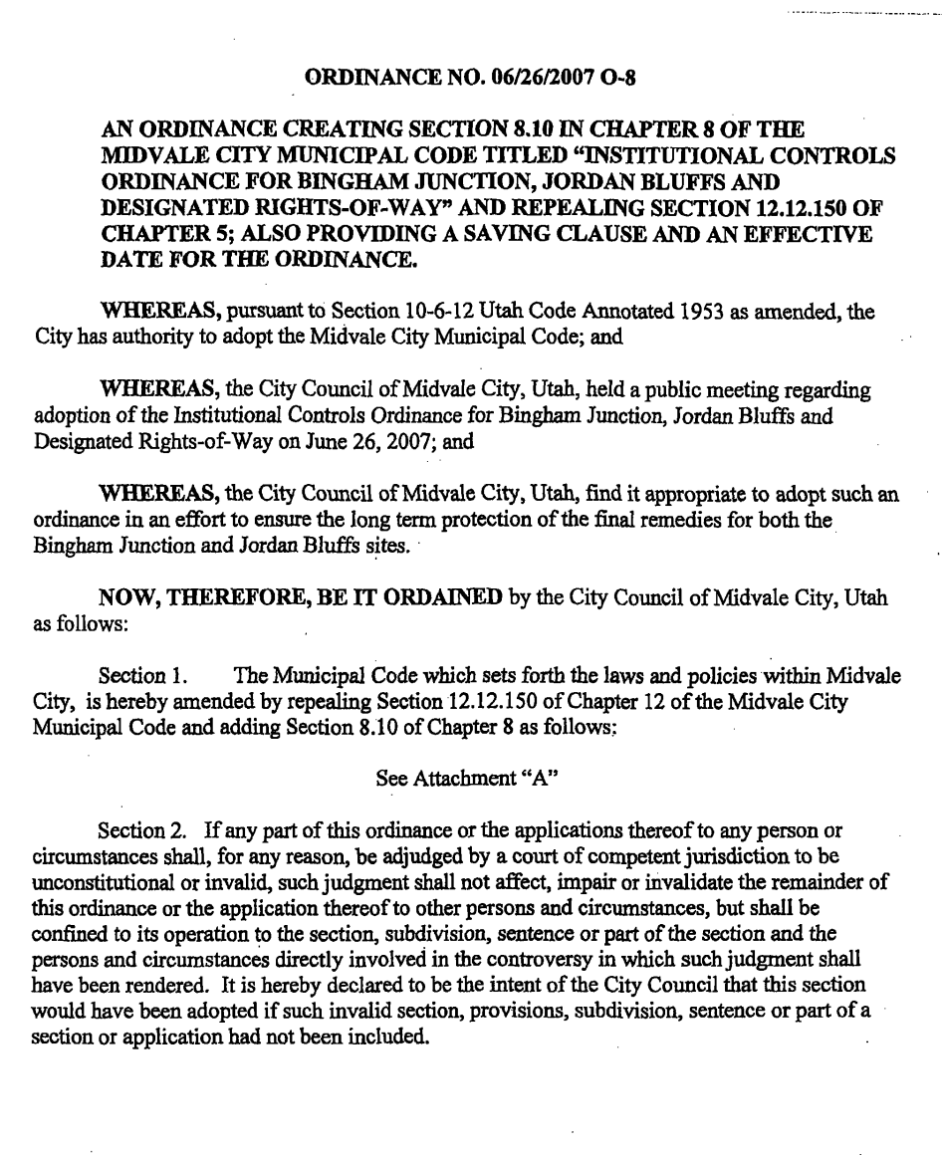
Case Study: Midvale, Utah
Midvale Slag Superfund Site
  2004: City, EPA, Utah DEQ, landowner execute Consent Decree for OU-2
  2006: EPA updates its 1995 ROD for OU-1 to reflect and accommodate City’s reuse/redevelopment plans
  2007: EPA completes its OU-2 remedy; City adopts comprehensive IC ordinance covering Midvale Slag and Sharon Steel Superfund Sites

Slide 22
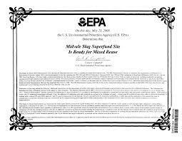
Case Study: Midvale, Utah
Sharon Steel and Midvale Slag Superfund Sites
  2008 to Today:
    Both Superfund sites delisted from NPL, have received “ready for reuse” certificates, and are redeveloped
    Sharon Steel → “Jordan Bluffs”
    Midvale Slag → “Bingham Junction”

Slide 23
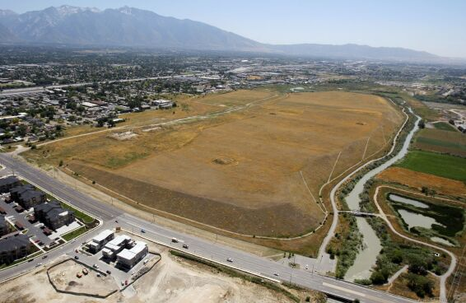
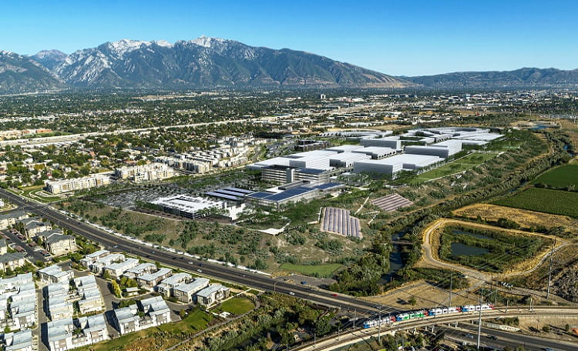
Case Study: Midvale, Utah
Sharon Steel → Jordan Bluffs

Slide 24

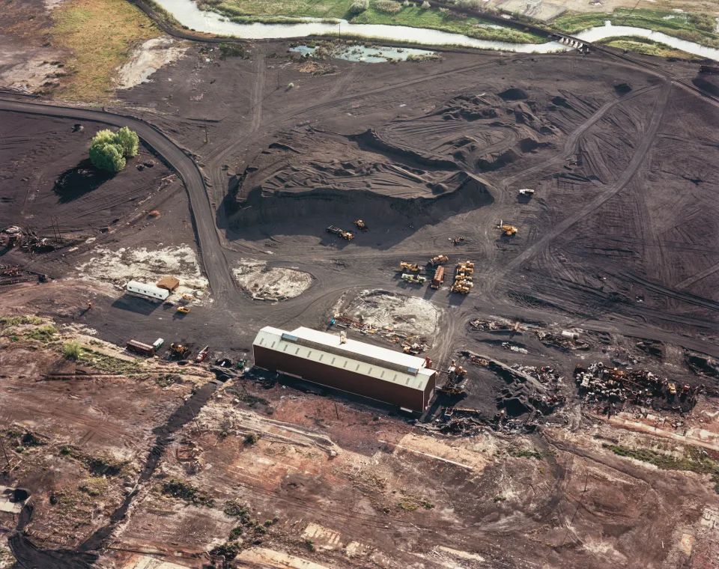
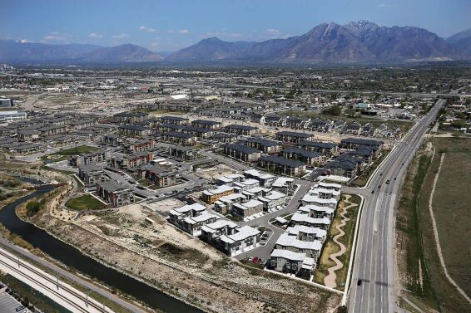
Case Study: Midvale, Utah

Slide 25
Case Study: Midvale, Utah
OBSERVATIONS:
  Important differences
    Midvale’s urban location
    Participating PRP/landowner
  Important similarities
    Superfund site profiles
    EPA’s remediation strategy

Slide 26
Case Study: Midvale, Utah
OBSERVATIONS:
  Key lessons -
    Municipal engagement of EPA affects remedial outcomes
    Municipal involvement results in municipal control of the community’s environmental future
    Municipal land use plans act as an institutional control and serve to achieve both reuse and environmental protection
    EPA is committed to integrating reuse and remedy design

Slide 27
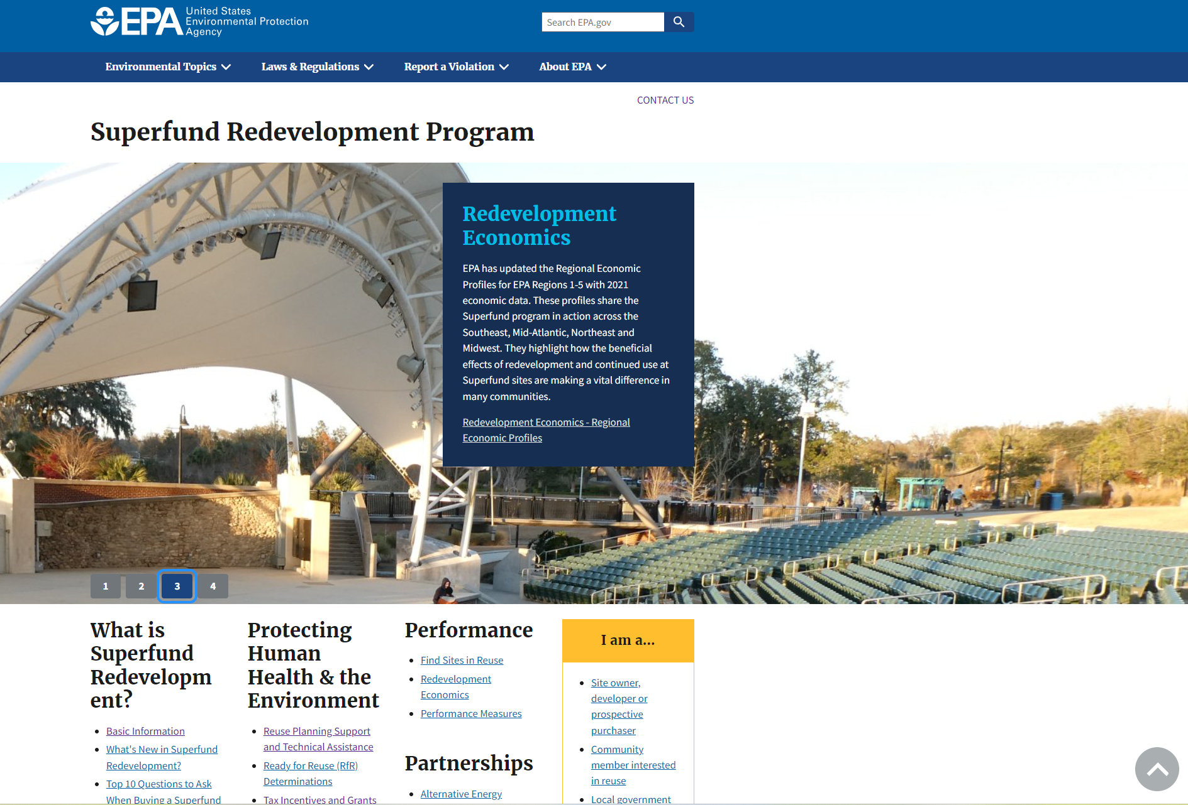
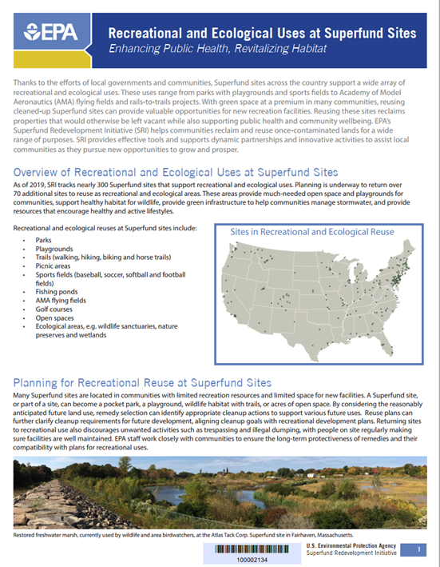
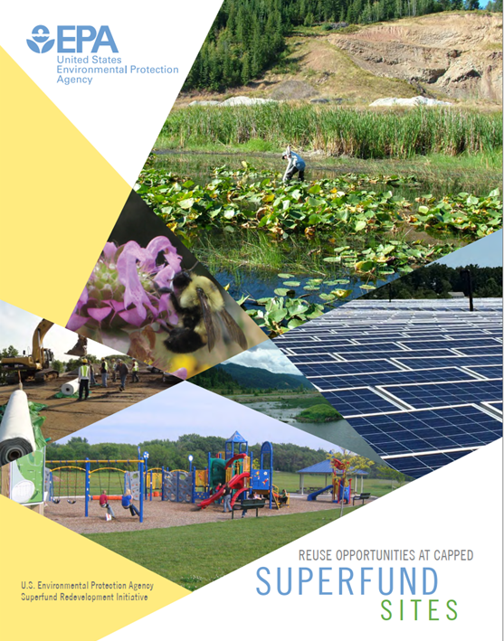
Case Study: Midvale, Utah

Slide 28
POTENTIAL ELEMENTS OF DEWEY-HUMBOLDT’S IC PROGRAM:
  General Plan Update
  Zoning Ordinance – Multi-Use Agribusiness (MUA) Zone
  Institutional Control Code
    MUA Development/Building Ordinance
    Soil Management Ordinance
    Environmental Impact Assessment (EIA) Ordinance
  Consent Decree

Slide 29
POTENTIAL PROPERTY OWNERSHIP ISSUES IN MUA ZONE:
  Construction/O&M of the waste repositories in the MUA zone implicate ownership issues
    EPA may want title to construct its remedy without obstruction or windfall to landowners and to ensure no future compromise of its remedy
    EPA cannot take title without ADEQ being willing to assume title after construction
    ADEQ will want some property interest to discharge its long-term O&M obligation to EPA
  These issues create opening for Town to explore becoming future title owner of waste repository sites slated for MUA reuse

Slide 30
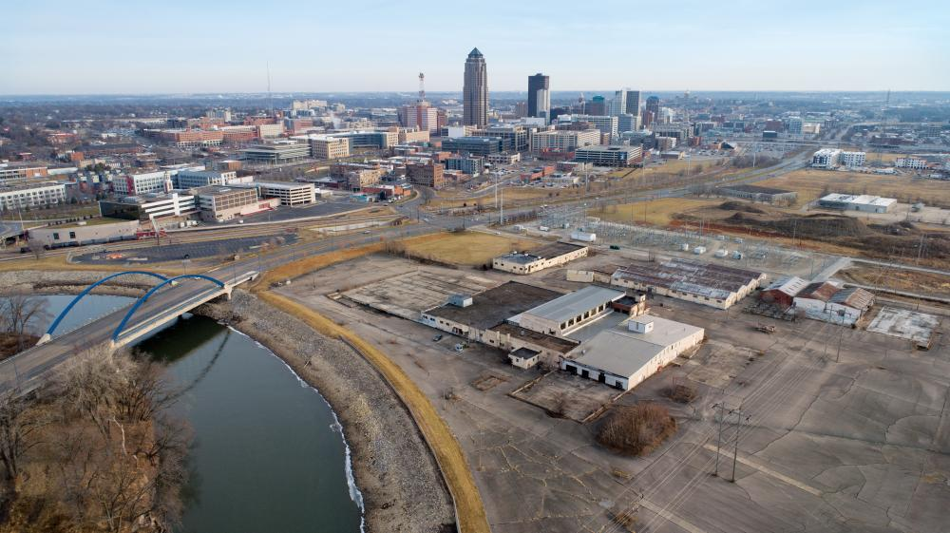
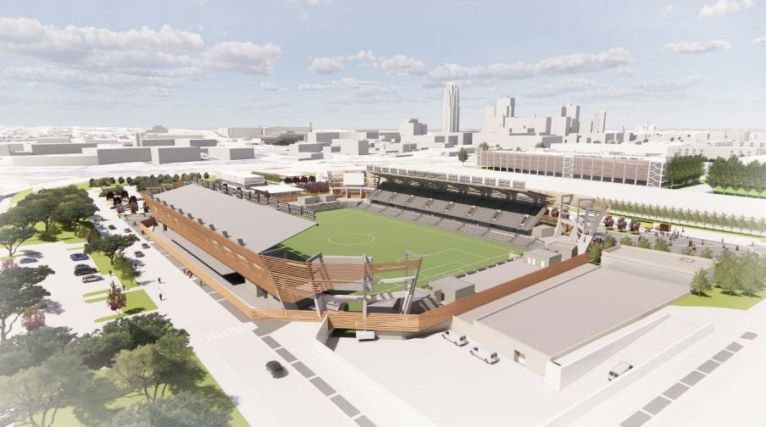
DES MOINES, IOWA EXAMPLE:
  Abandoned industrial site near downtown Des Moines
  Tied up in Superfund litigation for years
  In 2020, EPA and PRP settled liability
    EPA to conduct remediation
    PRP to relinquish property ownership
    City to acquire title and facilitate redevelopment
  Legal vehicle was federal consent decree

