Slide 1
Town of Dewey-Humboldt Soil Clean-up Standards
Environmental Advisory Team | Town of Dewey-Humboldt
Town Council Meeting | August 22, 2023

Slide 2
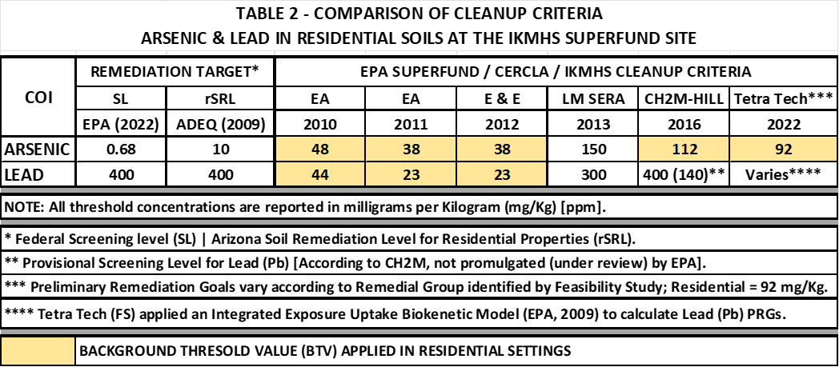
Soil Standards & Guidelines Standards Applied by EPA | Removal Actions

Slide 3
Soil Standards & Guidelines Recommended for Town of Dewey-Humboldt

Slide 4
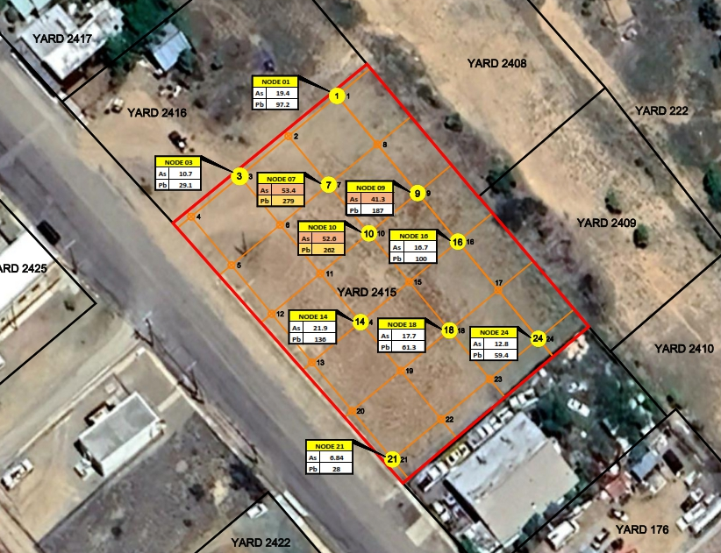
Town Property
Proposed Community Center
Agua Fria Days Festival Grounds

Slide 5
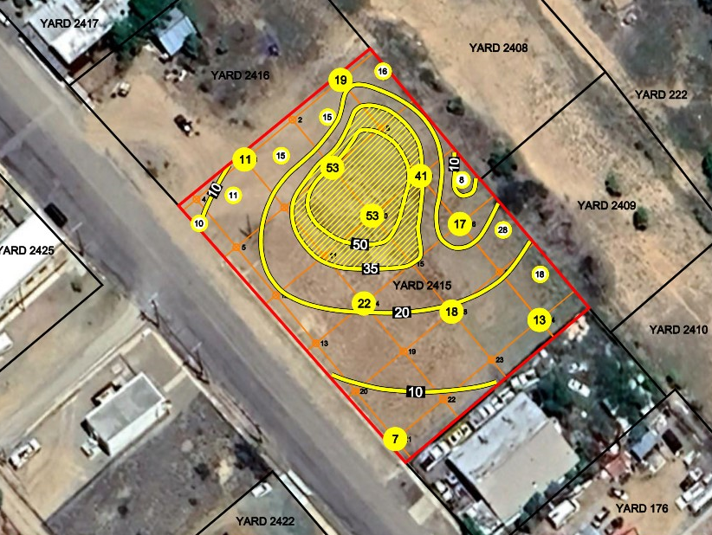
Town Property
Distribution of Arsenic in Property Surface Soils
Known Human Carcinogen
Surface Soils Represent a Possible Exposure to the Public by Inhalation & Dermal Contact
Arsenic Clean-up Standard is 35 mg/Kg (ppm) based on Local Soil Conditions

Slide 6
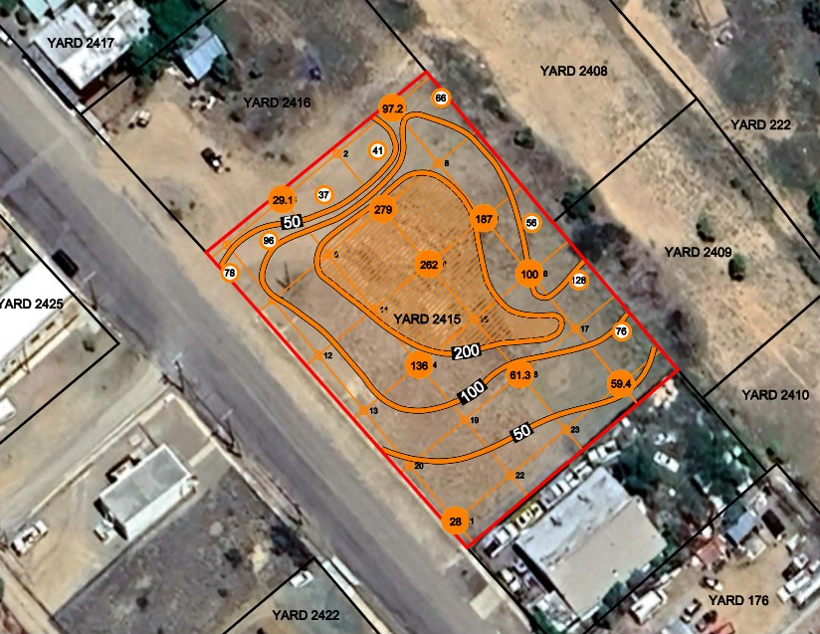
Soil Standards & Guidelines
Distribution of Lead in Property Surface Soils
Non-Carcinogen | Acute Toxicity
Surface Soils Represent a Possible Exposure to the Public by Inhalation & Dermal Contact
Lead Clean-up Standard is 197 mg/Kg (ppm) for Residential Properties | EPA

