Slide 1

TOWN FORUM | AGENDA
Residential Soil Sampling & data reports
Manganese occurrences
cleanup TIMELINE – IKM, HS, Residential soils
soil management ordinance
Questions & Answers

Slide 2
EPA Residential SOIL SAMPLING
In 2024, epa identified 374 properties for sampling
  213 property owners granted access (57%)
  153 property owners did not respond (41%)
  8 property owners denied access
EPA has final data and issued data reports for 56 properties
Additional data reports will be issued as data are validated

Slide 3
EPA Residential SOIL SAMPLING
complete residential soil sampling by end of 2025
additional parcels IDENTIFIED FOR SAMPLING | NEW consent requests forthcoming
Current consent requests may still be returned
Property owners who want epa sampling may request it if they:
  Identify location of parcel & location of nearest sampled property
  Property has not previously been sampled by epa

Slide 4


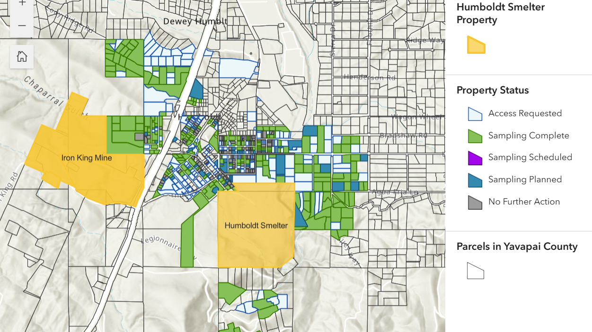

Slide 5
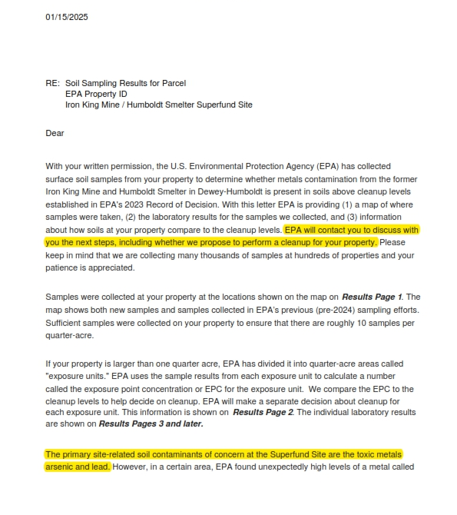
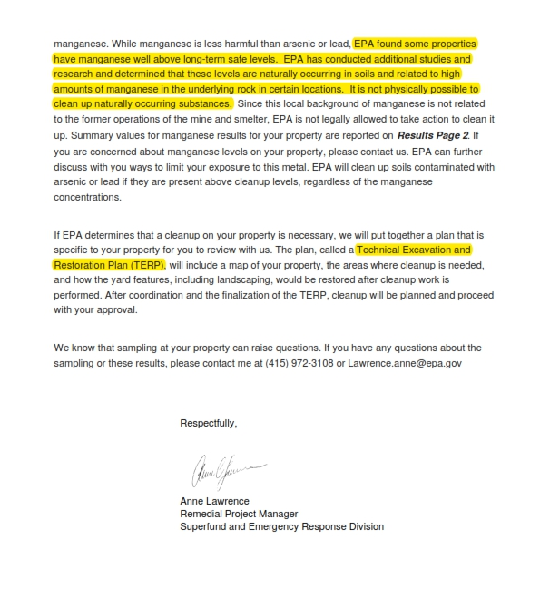

Slide 6
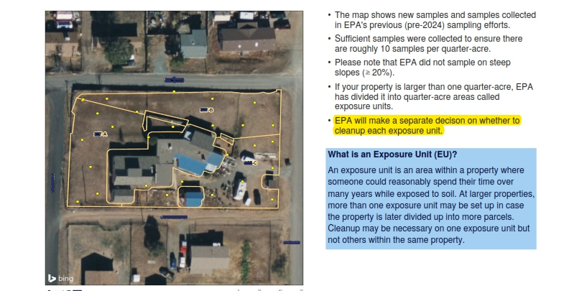

Slide 7
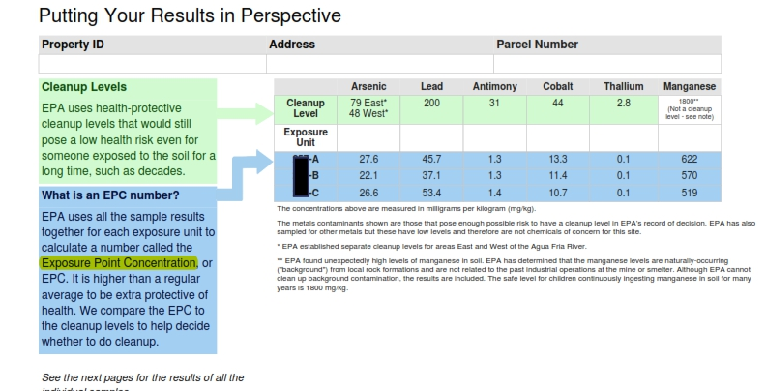
THE EPC IS CALCULATED USING A 95% UPPER CONFIDENCE LEVEL (UCL)

Slide 8
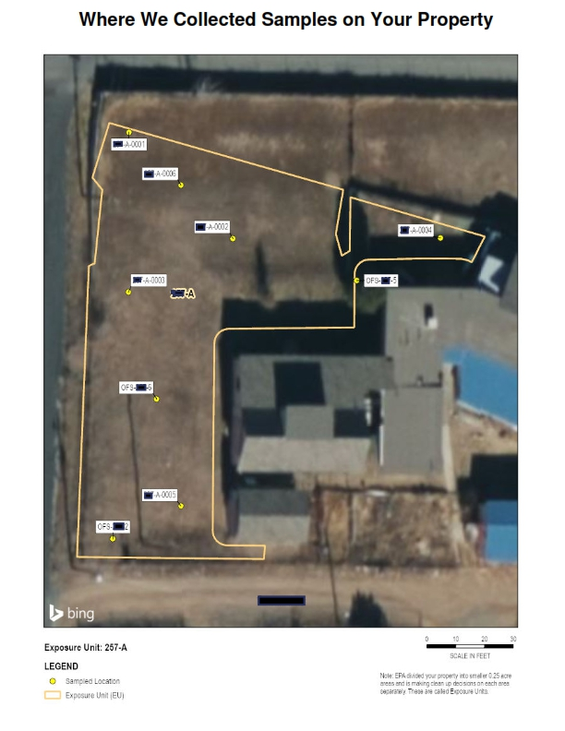
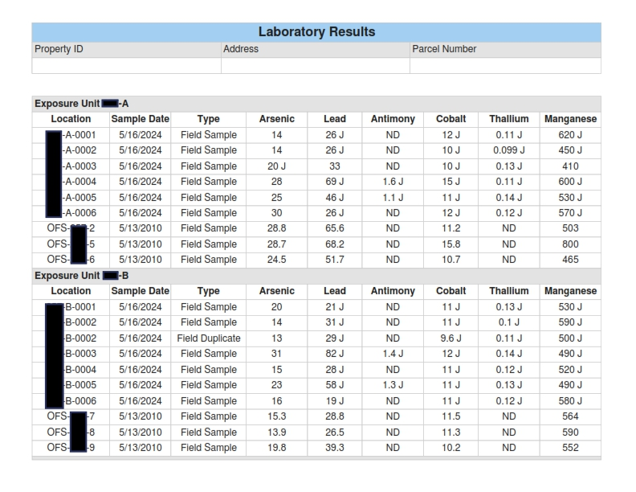

Slide 9
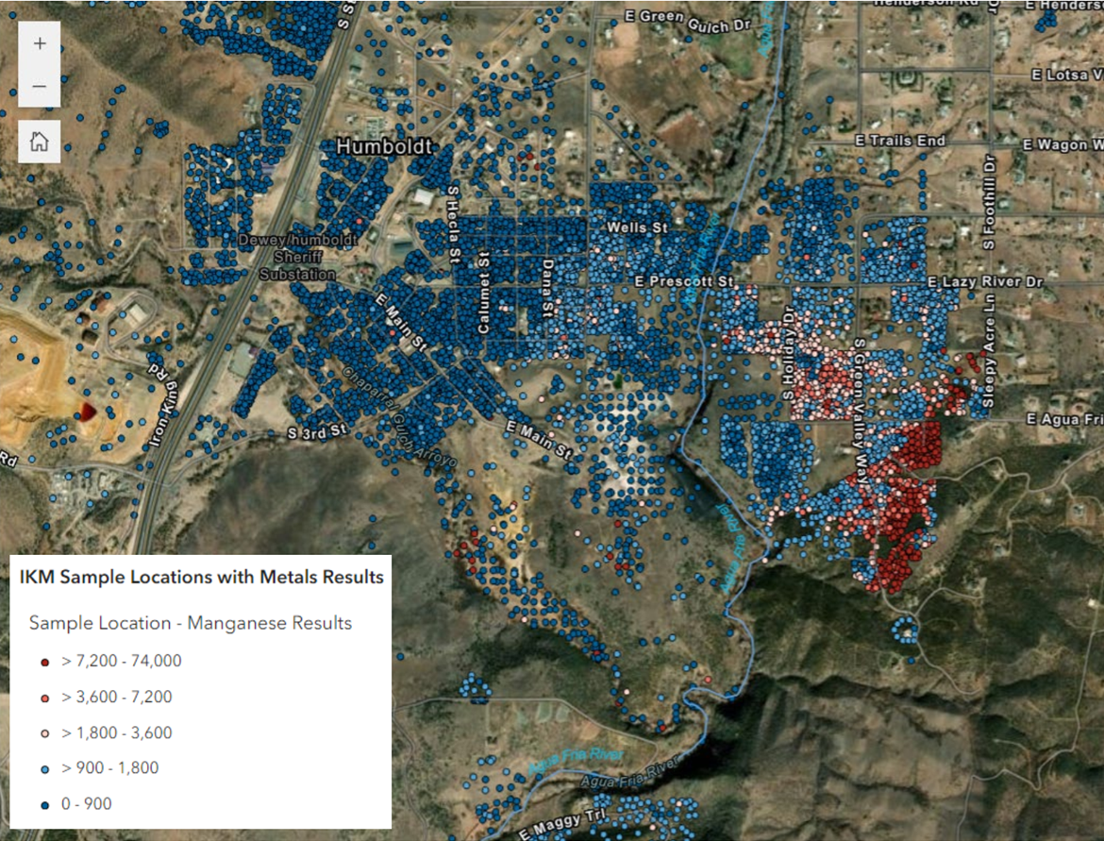

Slide 10
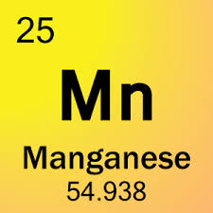
MANGANESE risk
INHALATION (FUGITIVE DUST)
INGESTION (soil and DRINKING WATER)
DERMAL CONTACT IS NOT A CRITICAL EXPOSURE ROUTE
Environmental exposures to airborne manganese have been associated with neurological and mood effects
Acute or intermediate exposure to excess manganese also affects the respiratory system
There is no evidence that manganese causes cancer in humans

Slide 11

Cleanup timeline
RESIDENTIAL PROPERTY REMEDIATION
  DESIGN HAS COMMENCED
  2ND QUARTER 2026 (2-4 YEARS)
Ikm-hs REPOSITORY DESIGN
  2ND QUARTER 2026 (2-3 YEARS)
Ikm-hs REPOSITORY CONSTRUCTION
  COMMENCES WHEN DESIGN ENDS (5-10 YEARS)

Slide 12
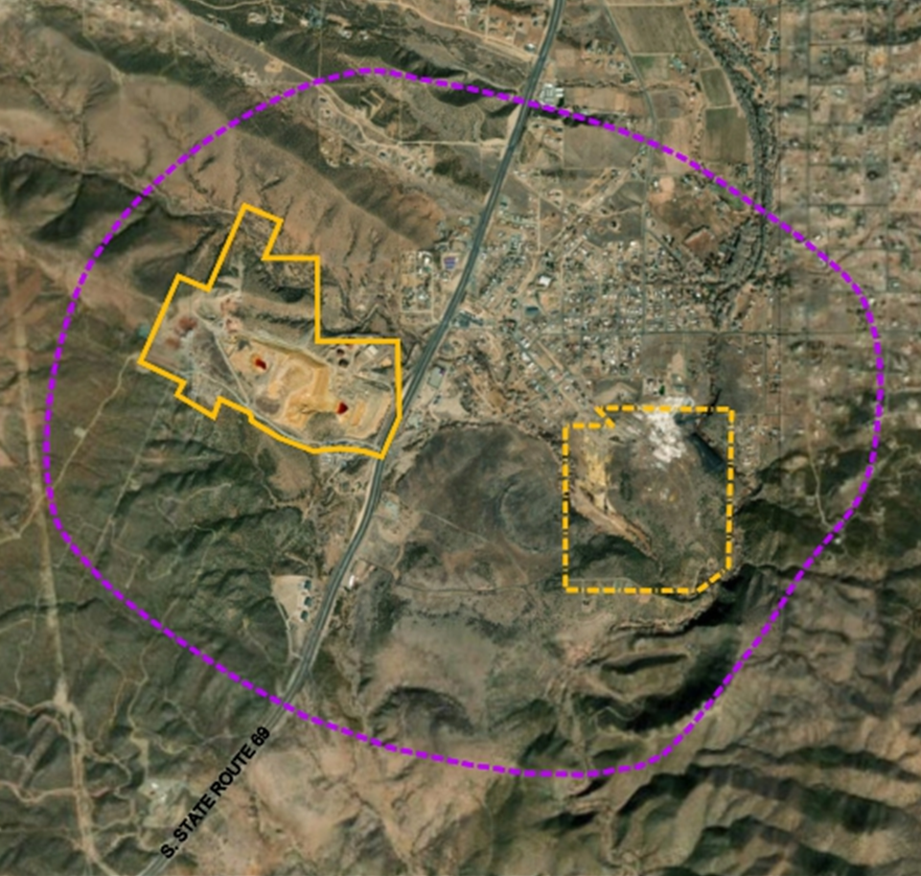
SOIL MANAGEMENT ORDINANCE
Limited to “SOIL Management district”
Exemption if EPA sampled/cleaned
Permit Req’d for intentional “soil displacements”
If no data, Soil sampling
Prescribed management standards

